Slide 1


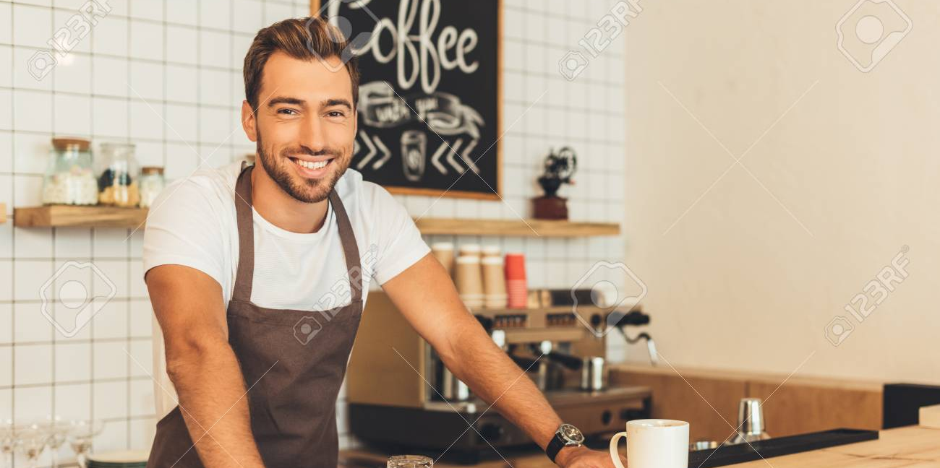
NAME OF COFFEE SHOP
Contact Information
Home
Our Coffee
Meet the Staff
Where are we?
Contact Us

Slide 2
NAME OF COFFEE SHOP
Contact Information
Home
Our Coffee
Meet the Staff
Where are we?
Contact Us

Slide 3
User Profile
Someone who is interested in Coffee-style drinks
Younger (likely between 16-30)
Likely to be sociable
Visit the site to find nearby coffee shops
Want to meet up with friends
Student

Slide 4
